Slide 1
Signals from local and national monitoring will guide us to nature recovery
Report summary - Marion et al. JNCC report 2025

Slide 2
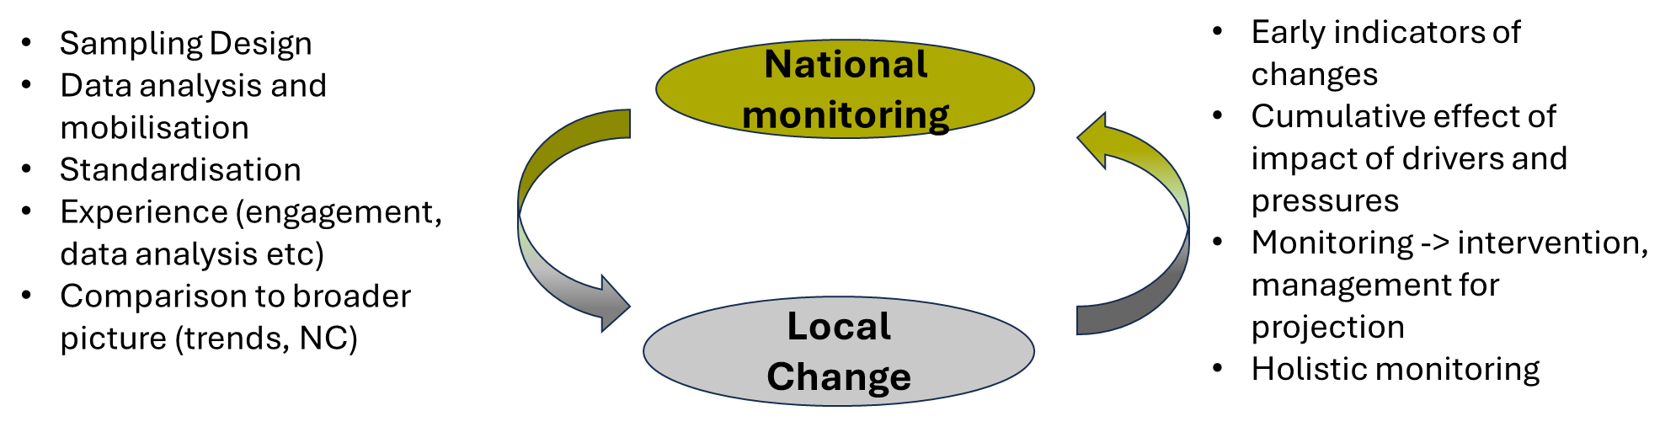
Why a local monitoring approach?
National citizen science monitoring is essential but often too slow or broad to inform rapid decision making.
Local monitoring provides early signals of change, enabling management and policy responsiveness.
Key benefits of a local change monitoring
Reduces measurement lags, offers early indications of change, and allows for interventions.
Provides context-specific data, helping track progress towards global targets, inform decisions, and link ecological trends to specific policies, thereby improving the effectiveness of conservation actions
Provides evidence for enabling projections
Complementing national monitoring
National and local monitoring need to work together to complement evidence needs

Slide 3

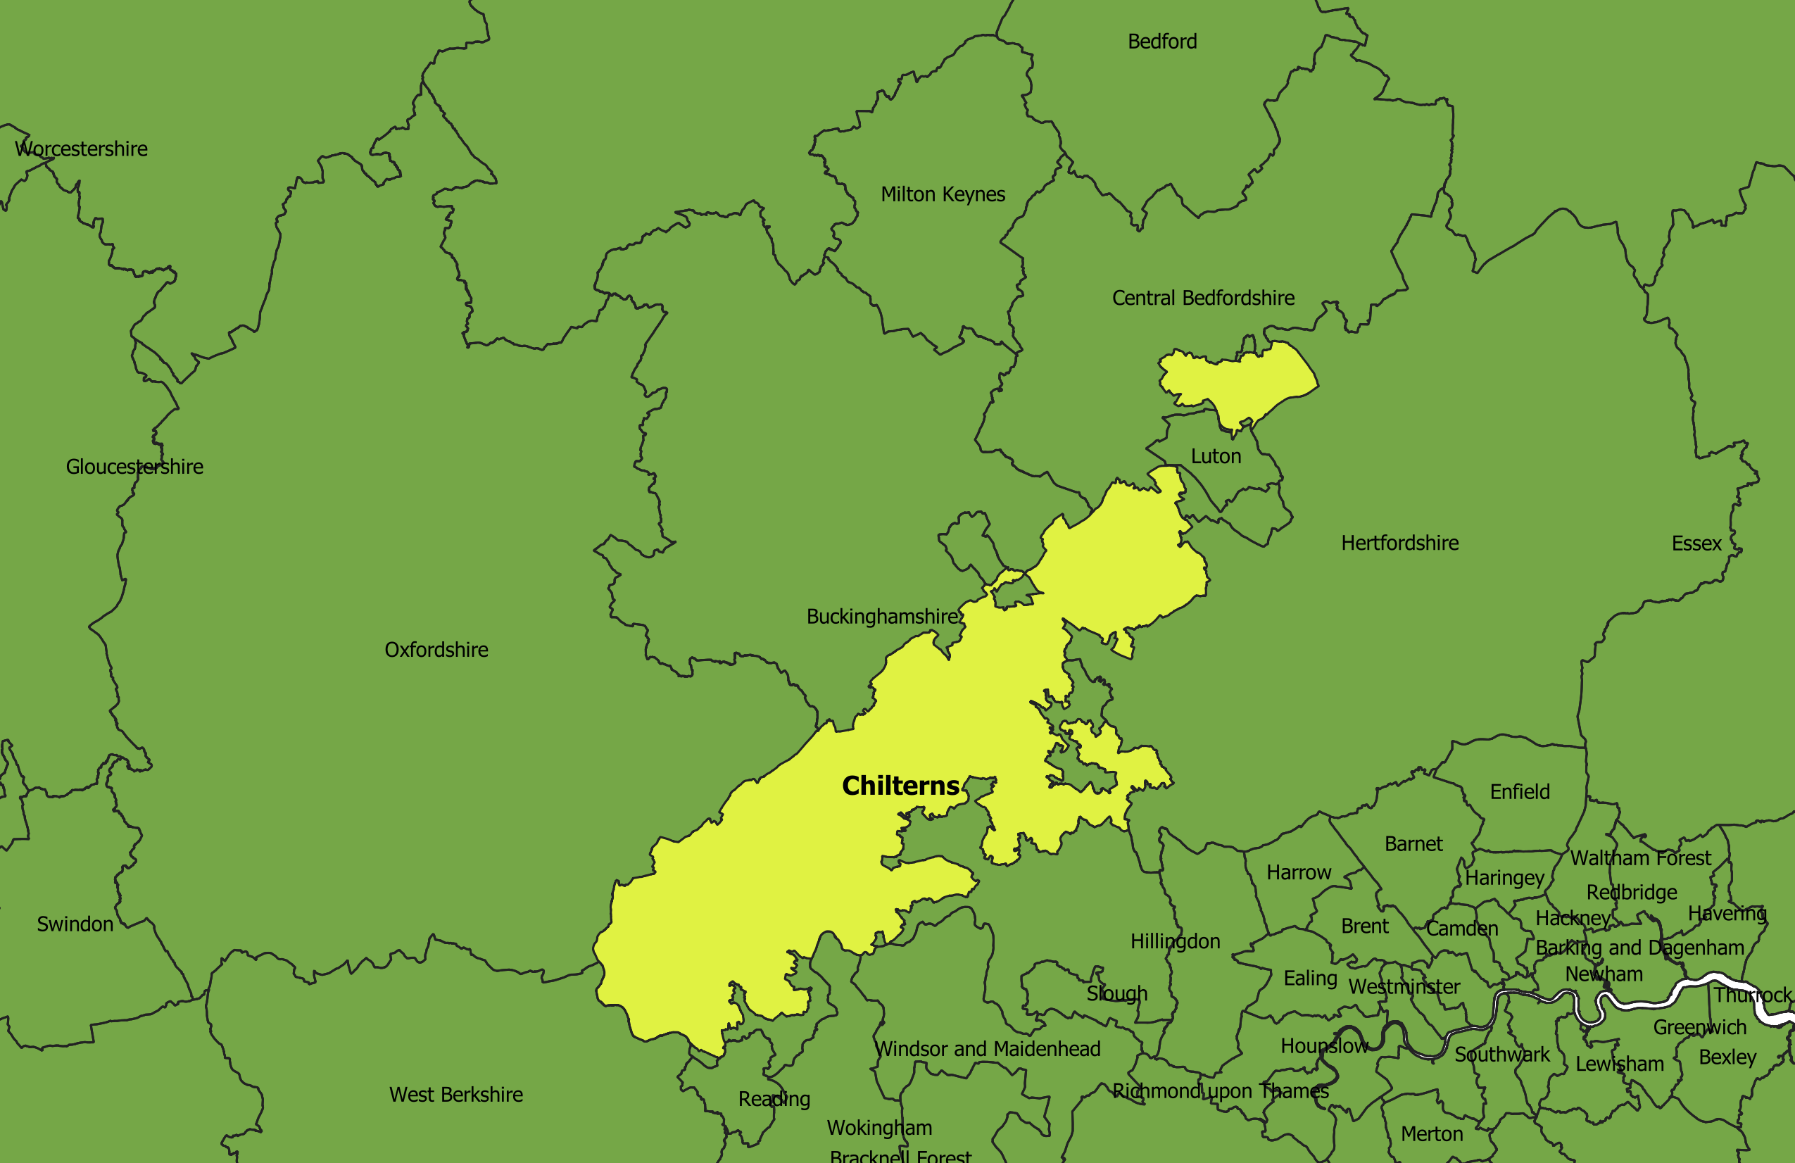



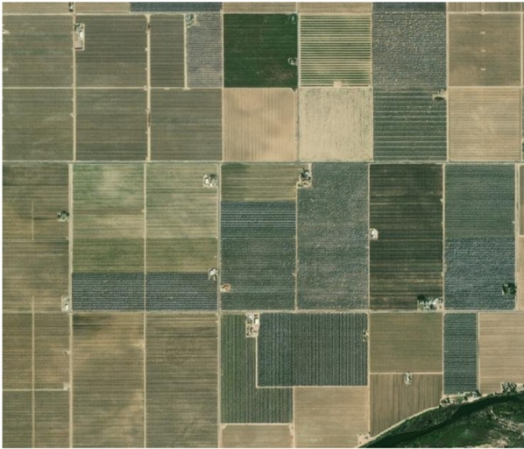
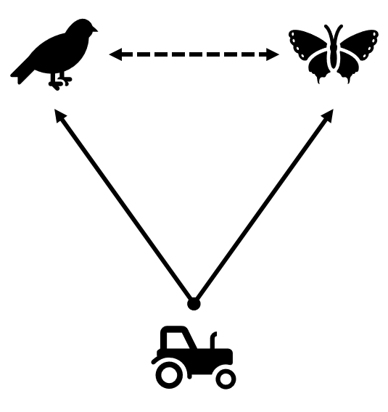
Why a local monitoring approach?
Consistency and standardisation of methods across projects allows for easier uptake, and results in a broader evidence base, easier comparison and counterfactual. Two approach of monitoring are useful together:
BACI (Before After Control Impact)
Landscape
Assess intervention level
Assess scale of impact
Centrally deployed
Test intervention for direct feedback on impact at site scale
Locally led
Landscape scale: appropriate to effect size
Example
Habitat creation
X Repetition across country and aggregation results
Multi-species, to test multi-intervention (e.g., compare local trends to national, evaluate population level changes, identify complex ecological responses)
n Before =1
n After =3
Impact: Intervention “habitat creation” increase bird abundance of XX for Xx ha
Standardisation of protocols allow to use evidence for policy and modelling
Early evidence for policy and modelling

Slide 4
Evidence fills
Together national and local monitoring using citizen science can fulfil different evidence needs.
Working across the different evidence need type will help nature recovery by understanding how sets of policy and interventions/investment can impact biodiversity and natural capital in short and long term.
Decision making
Guide and assess policy
Inform interventions and investments
Supporting tools
Decision support tools
Modelling
(Projection, scenarios seeking)
Assessing and reporting change
Status of biodiversity, NC, and habitat
Roles of drivers/pressures
Policy relevant research
Monitoring at national and local scale

Slide 5
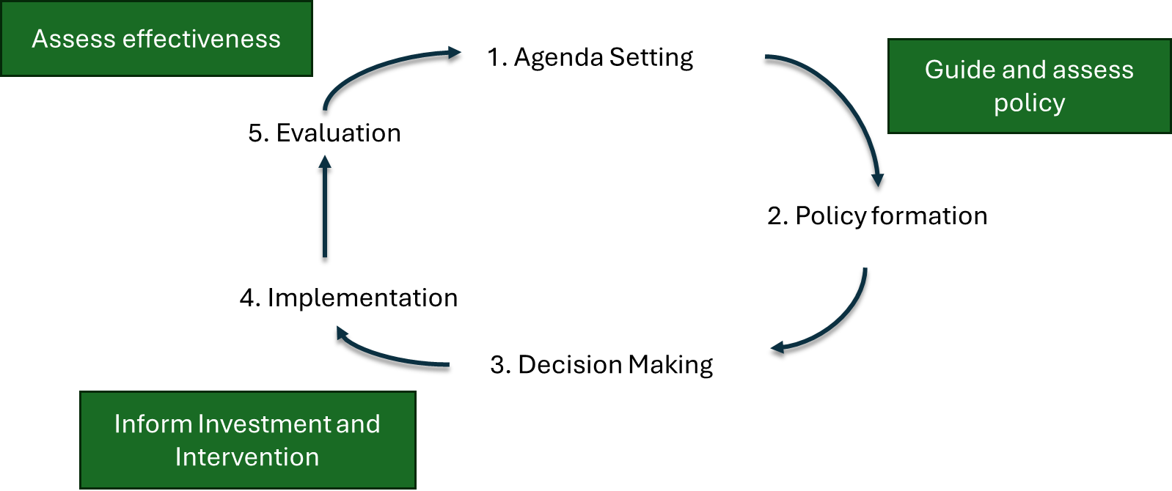
Local change for Projection and Policy
Evidence for Policy
Policymakers need robust evidence to create, adapt, and evaluate environmental policies.
National frameworks like England’s Environmental Improvement Plan (EIP) set broad goals, but local monitoring is essential to assess progress
Local data helps identify early outcomes and supports more responsive, place-based policy decisions.
Decision Support Tools
Tools like JNCC’s spatial prioritisation help identify the most effective land management interventions.
These tools rely on data about natural capital (e.g., habitat quality, ecosystem services) to guide decisions at both national and local levels.
Localised evidence ensures that interventions are context-appropriate and impactful.
Scenario Modelling
Models simulate biodiversity outcomes under different future scenarios to guide strategic planning.
Reliable projections require up-to-date, multi-scale data on species, habitats, and pressures

Slide 6
Local change for investment and intervention
Private and public investments need to know the return on benefit of their action
  Monitoring is essential to evaluate the effectiveness of interventions and investment across scales
  Prediction about the return to investment/impact of intervention is necessary
    This requires modelling models that simulate biodiversity outcomes under different future scenarios to guide strategic planning.
    Reliable projections require up-to-date, multi-scale data on species, habitats, and pressures
Interventions and investments are interlinked: An intervention (e.g., habitat restoration) often requires investment, and investments can lead to multiple interventions.
Scale matters:
  National-level investments aim for broad impact.
  Local investments are more focus and relevant to community needs.
Evidence-based allocation of limited conservation resources ensures maximum environmental and economic impact.
Effective monitoring involves comparing managed areas before and after interventions, or against control sites, to understand what works and why.

